Slide 1
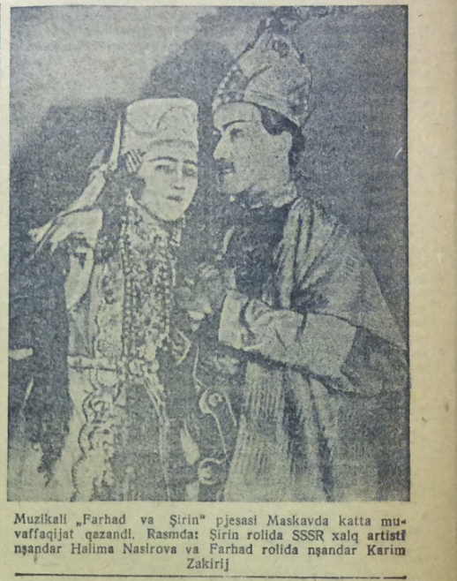
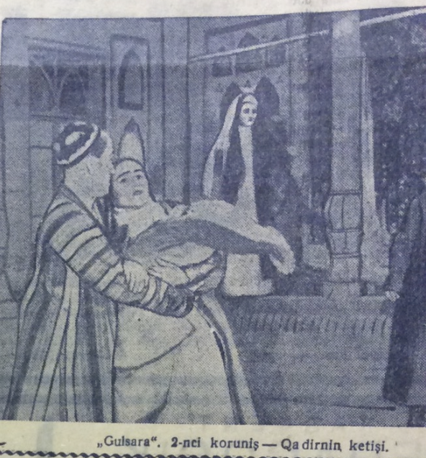
Yalla frontman Farrux Zokirov’s father and (infant) elder brother at the 1937 Dekada of Uzbek Art
Sources: Qizil O’zbekiston, June 5 and 6, 1937

Slide 2
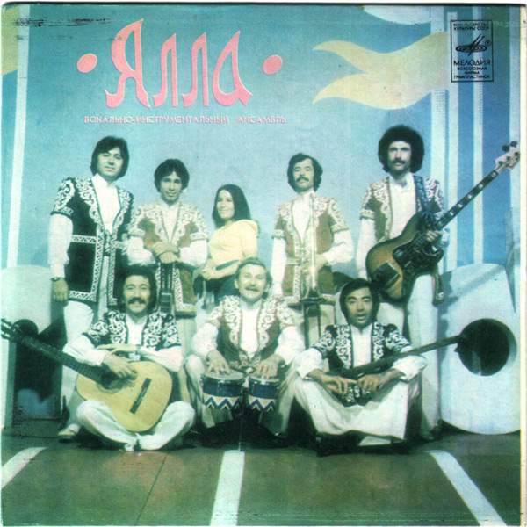
Yalla in “national” jackets, 1978 album cover

Slide 3
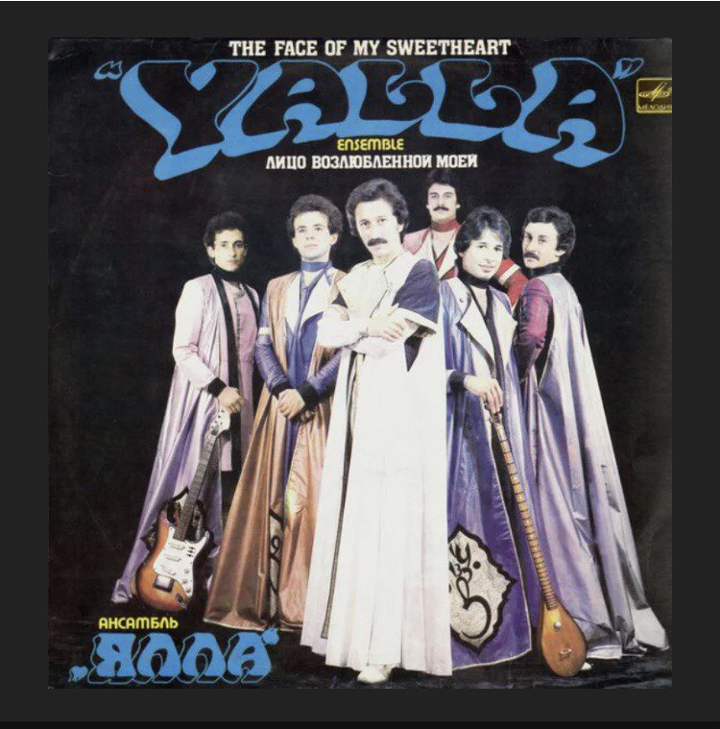
Yalla wearing the first set of costumes designed by Kozhenkova, 1983 album cover

Slide 4
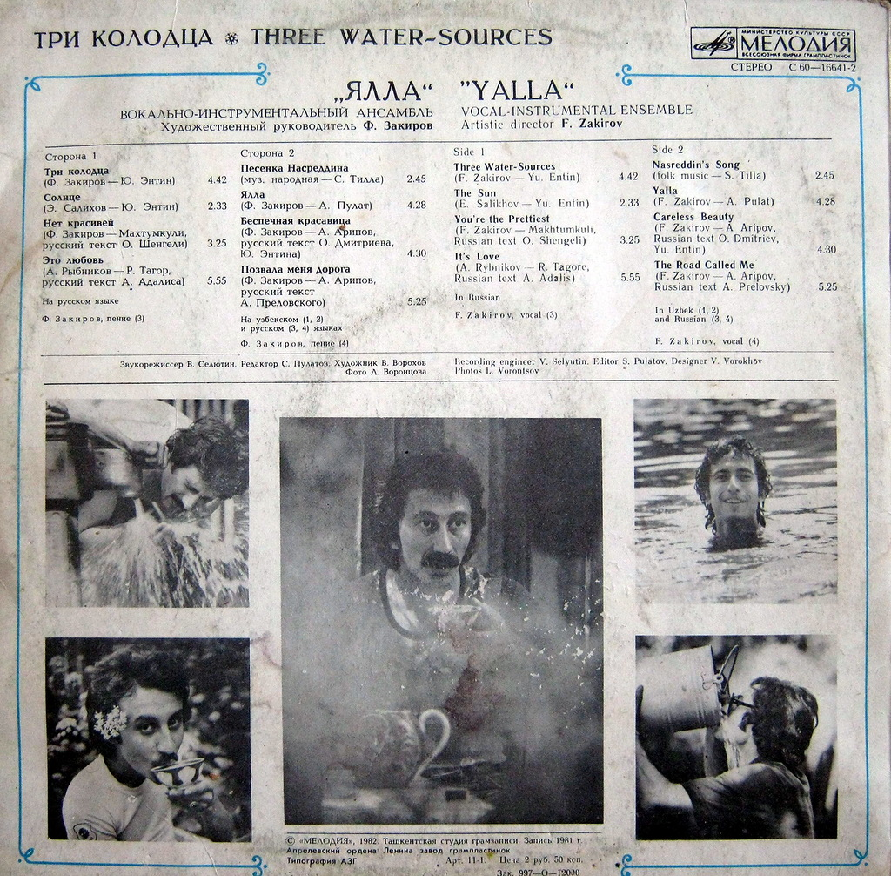
“Uchquduq” album cover, 1981

Slide 5
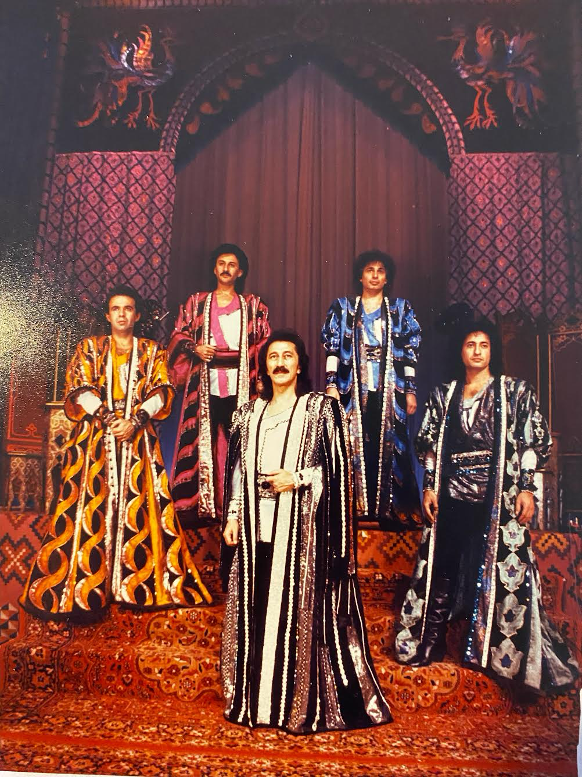
Yalla wearing Kozhenkova’s costumes for “The Teahouse for All Time,” late 1980s

